Slide 1
USA HOUSING MARKET

Slide 2
INTRODUCTION
The USA housing market has grown very competitive
Several expensive housing markets has seen unprecedented growth
USA housing market depends on various macroeconomic factors such as population, mortgage rates , etc.
This is a descriptive analysis to demonstrate how these factors affects the housing market.

Slide 3
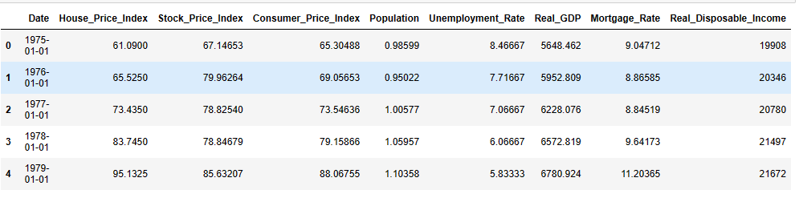
DATA
The data used is an already processed microeconomic csv file from IBM cloud storage (Data source)
The data possess attributes that contributes to the housing markets in the United States
Overview of the data head

Slide 4
DATA Cont’d
Date: Year
House Price Index: House price change according to the index base period set (you can check the date at which this value is 100).
Stock Price Index: Stock price change according to the index base period set (you can check the date at which this value is 100).
Consumer Price Index: The Consumer Price Index measures the overall change in consumer prices based on a representative basket of goods and services over time.
Population: Population of USA (unit: thousands).
Unemployment Rate: Unemployment rate of USA (unit: percentage).
Real GDP: GDP with adjusted inflation (Annual version unit: billions of chain 2012 dollars in, Monthly version unit: Annualized change).
Mortgage Rate: Interest charged on mortgages (unit: percentage).
Real Disposable Income (Real Disposable Personal Income): Money left from salary after all the taxes are paid (unit: billions of chain 2012 dollars).

Slide 5
EXPLORATION AND DESCRIPTION

Slide 6
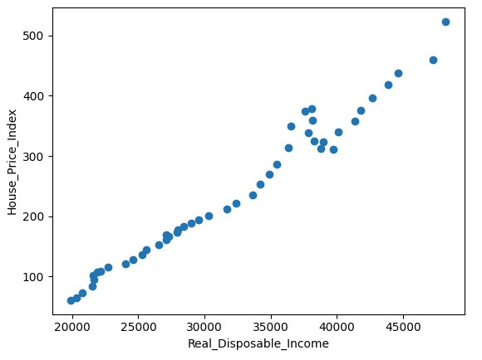
There is a positive relationship between House Price Index and Real Disposable Income with a correlation coefficient of approximately 0.99
This indicate a very strong positive relationship between both attributes
Therefore a rise in either factor will cause an equivalent rice in the other

Slide 7
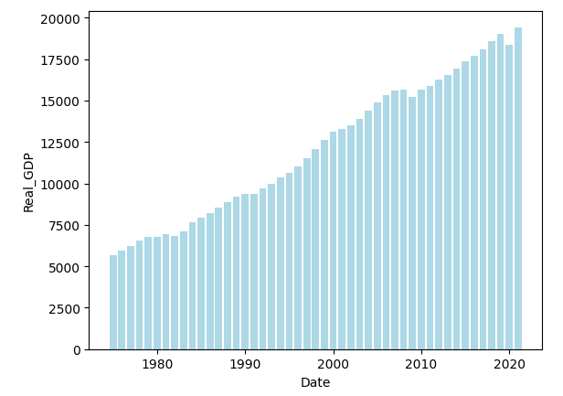
Throughout the years there has been a constant increase in the Real GDP

Slide 8
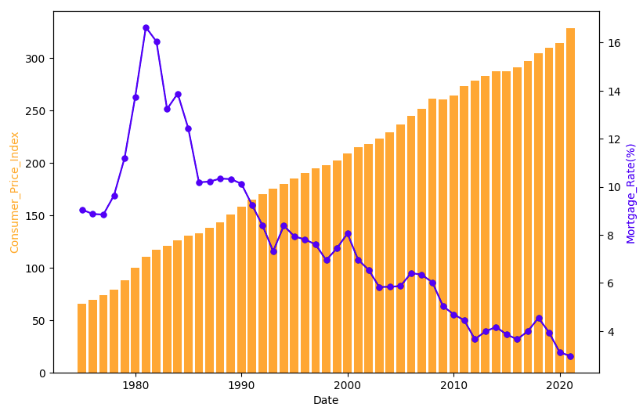
There is a negative relationship between Consumer Price Index and Mortgage rate with a correlation coefficient of approximately -0.85
Hence increasing Consumer Price Index across the years corresponds to decreasing Mortgage rate

Slide 9
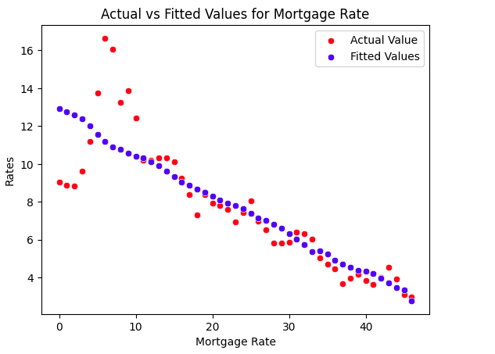
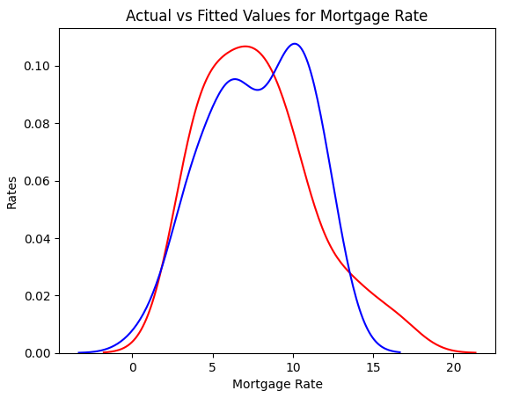
Predicting Mortgage Rate values
Linear Regression model fitness
Mortgage rates = 15.417739575612254(Consumer Price index) - 0.03845497
Multiple Linear Regression fitness
Mortgage rate = 0.03437288(House Price Index) + 0.03863097(Consumer Price Index) - 0.00124254(Real Disposable Income)

Slide 10
Thank You

